Slide 1
Chapter04 WEB SERVER
Session 01
WEB SERVER Introduction

Slide 2


OBJECTIVES FOR TODAY
Understanding how WEB Server work
Identify the important of WEB server for web development
Explain how web client connect to web server

Slide 3


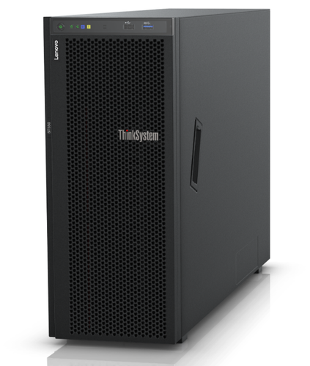
ENGAGE
3 MIN
Why do we need web server?
How web servers work?
Do web server need Internet?
How do web servers communicate?

Slide 4
What is a Web Server?

Slide 5


EXPLAIN
WEB SERVER
5 MIN
A web server is a computer server that hosts web pages, making them accessible online.
Web server stores and delivers the content for website – such as text, images, video, and application data to clients that requested.
Web server communicates with a web browser using HTTP protocol by default.

Slide 6
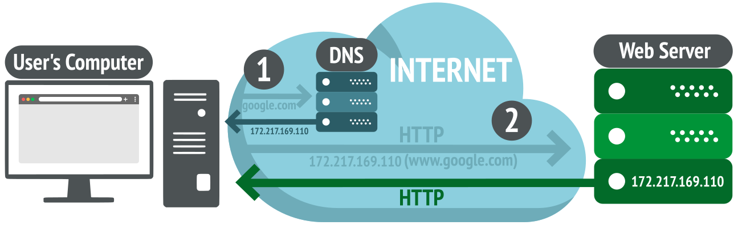
EXPLAIN
Web Server Works
5 MIN

Slide 7


What is the port that HTTP protocol use for communication?
HTTP protocol using TCP port 80.

Slide 8
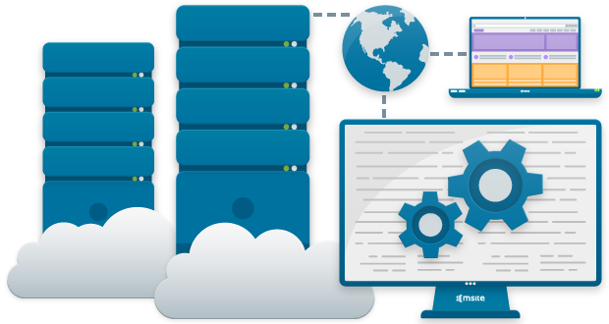

How to make a computer become Web Server ?
What are the type of Web Server Software?

Slide 9
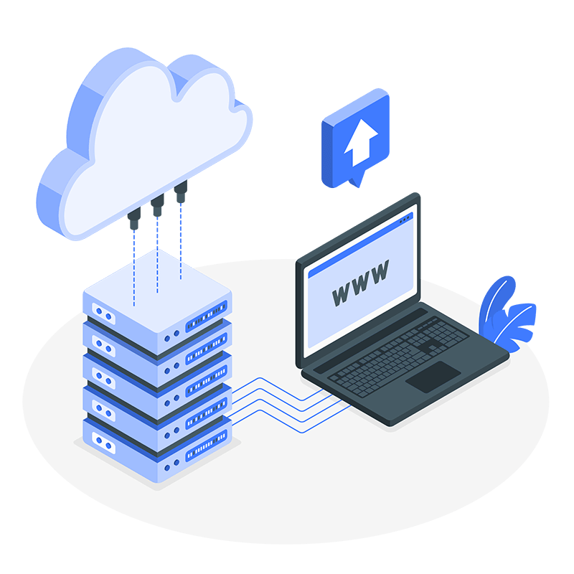
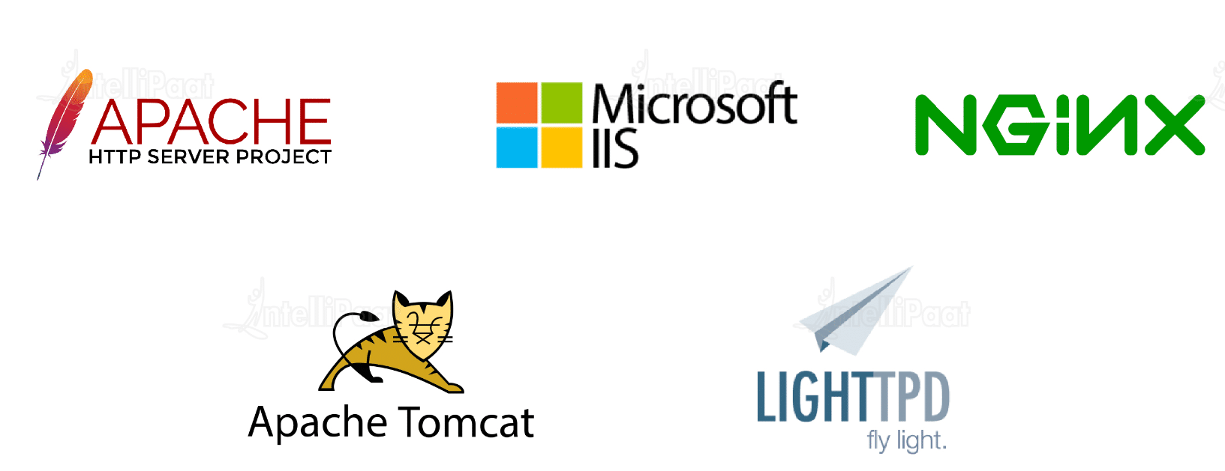
EXPLAIN
Type of Web Server Software
To setup a computer become a web server you need to configure web server software.
Here are the type of Web server software:

Slide 10

ACTIVITY
1. List down at least 5 popular websites that you know.
5 MIN
ACTIVITY 1
2. Where are those websites hosting?

Slide 11

How to host a website?

Slide 12

ENGAGE
How many ways to host a website?
3 MIN
What does hosting mean?
What is Web Hosting Service?

Slide 13
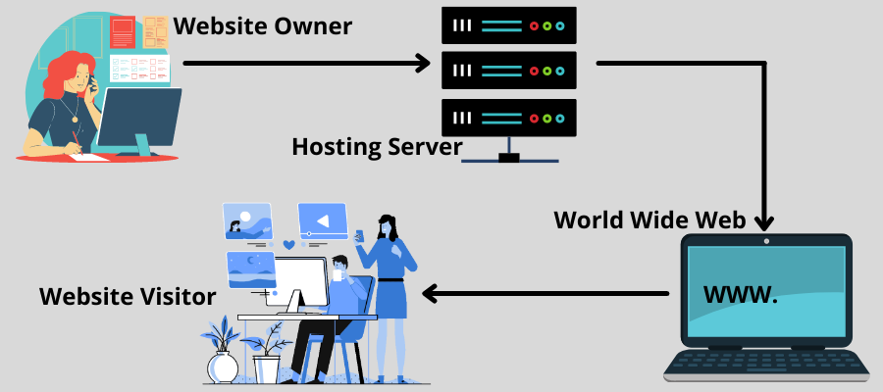
EXPLAIN
What is Web Hosting Service?
5 MIN
Web hosting is a service that makes the website accessible and available to the internet (online).
Web hosting provider is a company which offers services and technologies required for website to be viewed on the Internet.

Slide 14









EXPLAIN
Web Hosting Providers
5 MIN
Notes:
- Web hosting provider is a company that provides web hosting services for websites, usually paid for through a subscription model.

Slide 15
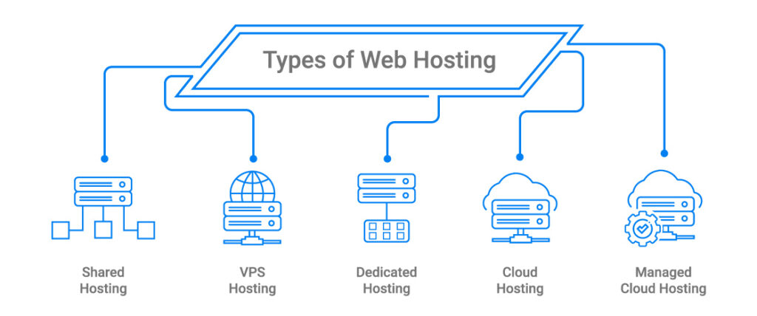
EXPLAIN
Web Hosting Plans
5 MIN

Slide 16

EXPLAIN
Hosting your website (Guideline)
5 MIN
Compare hosting companies
Choose a website hosting company
Choose a website hosting plan (subscription platform)
Register a public domain name

Slide 17
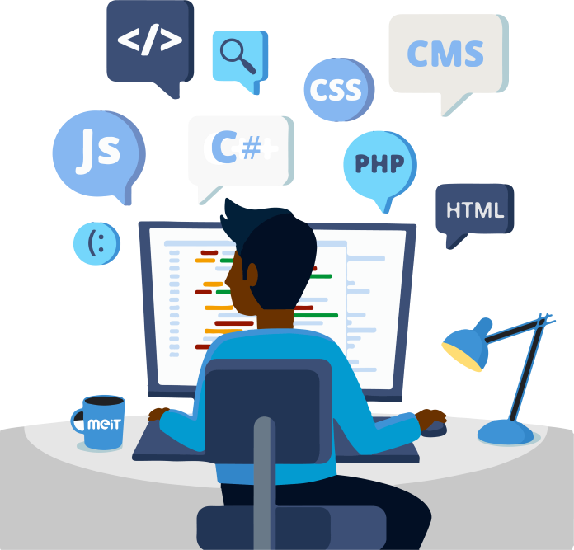
Backend & Frontend

Slide 18
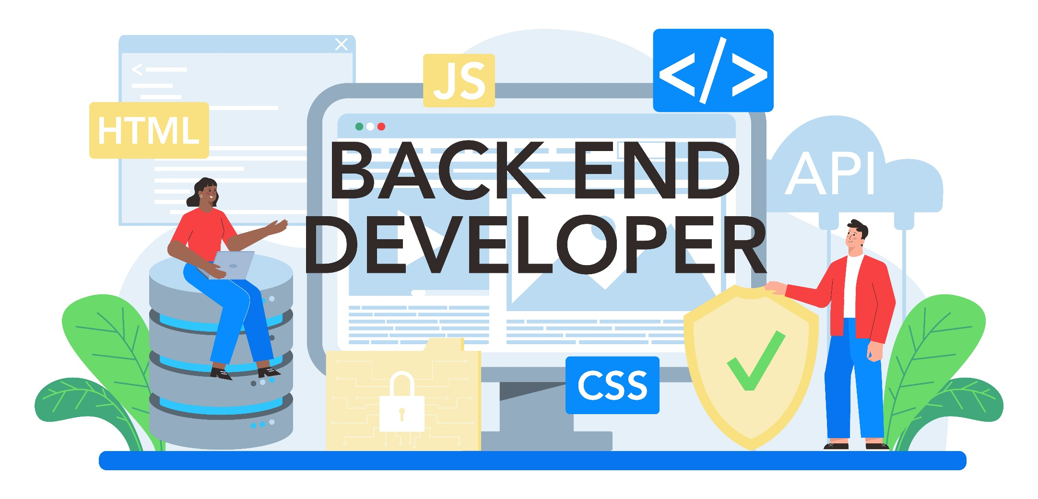

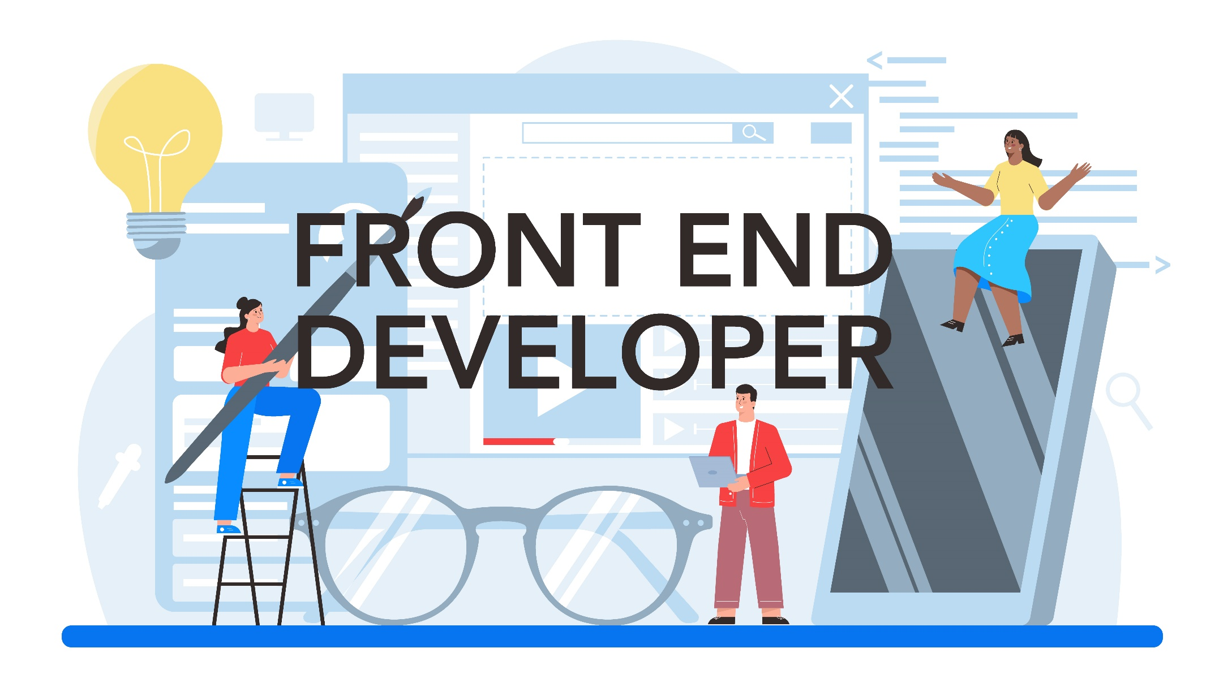

Slide 19
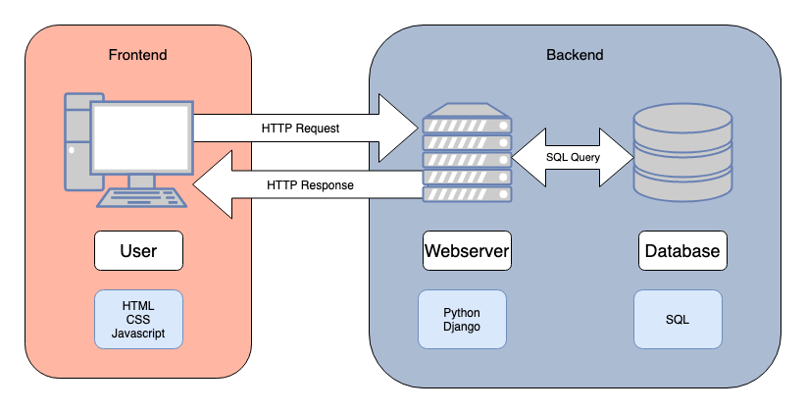
EXPLAIN
Back-End vs Front-End
5 MIN

Slide 20
EXPLAIN
Back-End vs Front-End
5 MIN
Frontend
The process of adding functionality to graphical user interface (UI) to create web experiences
Focus on how website and application look
The area of application or website with which visitors interact directly.
Language : CSS, HTML, JavaScript…
Frameworks: React, Angular, Vuejs …
Backend
The process of creating the logic, databases, and data structures of a web app.
Focus on how website or application work
Known as the “server-side” is the side that users do not see.
Language : PHP, Python, Ruby…
Frameworks : Laravel, Express JS…

Slide 21
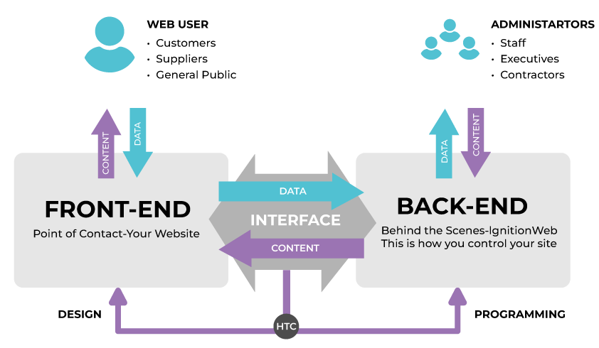
EXPLAIN
Back-End vs Front-End
5 MIN

Slide 22
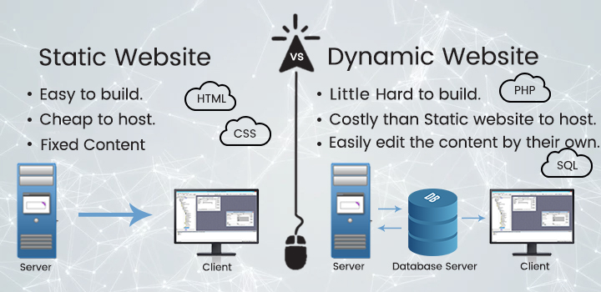
Static vs Dynamic Website

Slide 23

DEMO
5 MIN
Demo about Backend and Frontend
On PNC Timetables

Slide 24
Web Communication

Slide 25
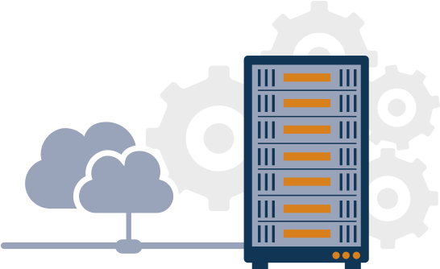

How end-user connect to Web Server?

Slide 26
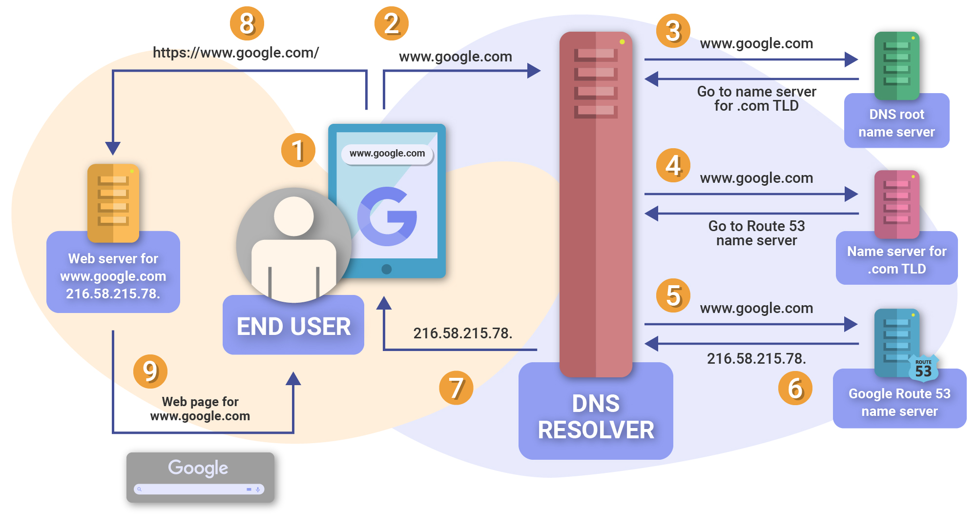

Slide 27
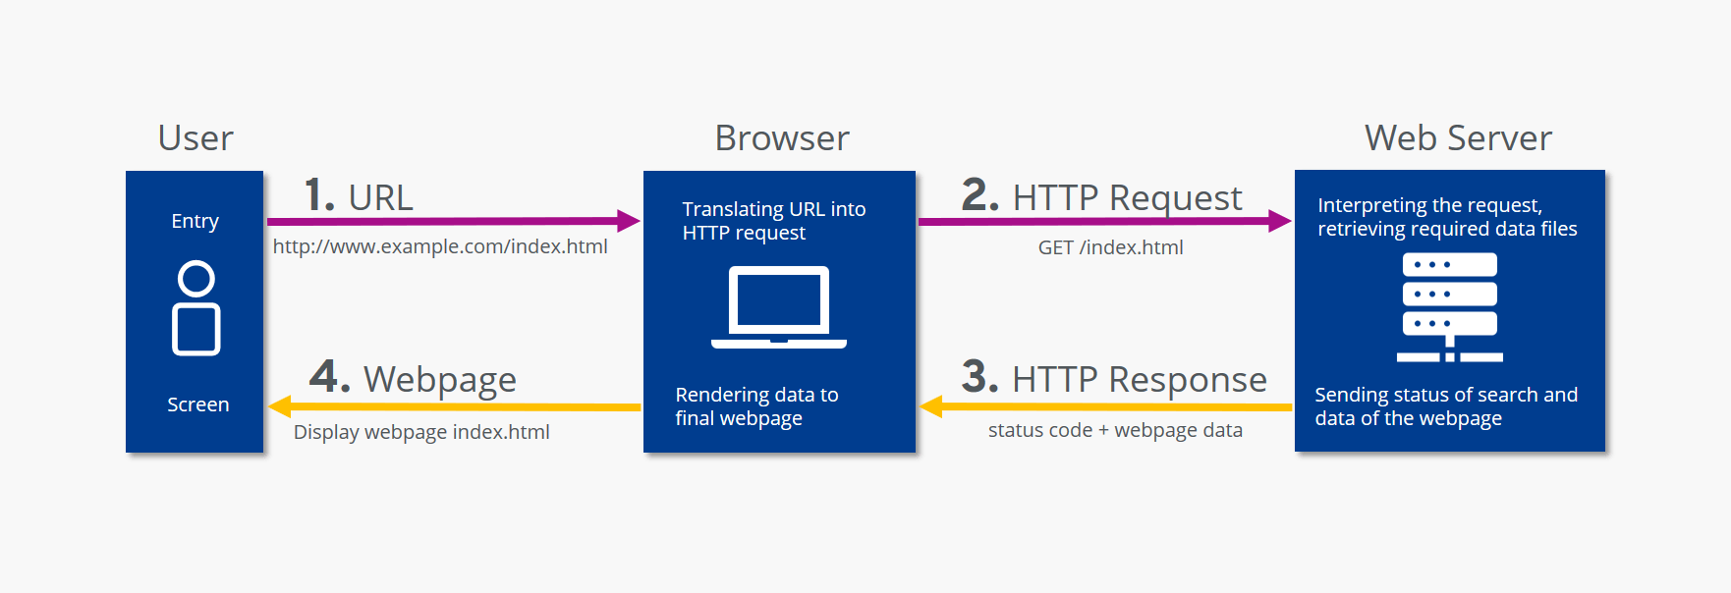
EXPLAIN
Web communication according to HTTP
5 MIN
https://www.ionos.co.uk/digitalguide/hosting/technical-matters/what-is-http/

Slide 28


DEMO
5 MIN
Hosting a website on Apache Web Server !

Slide 29


